Slide 1
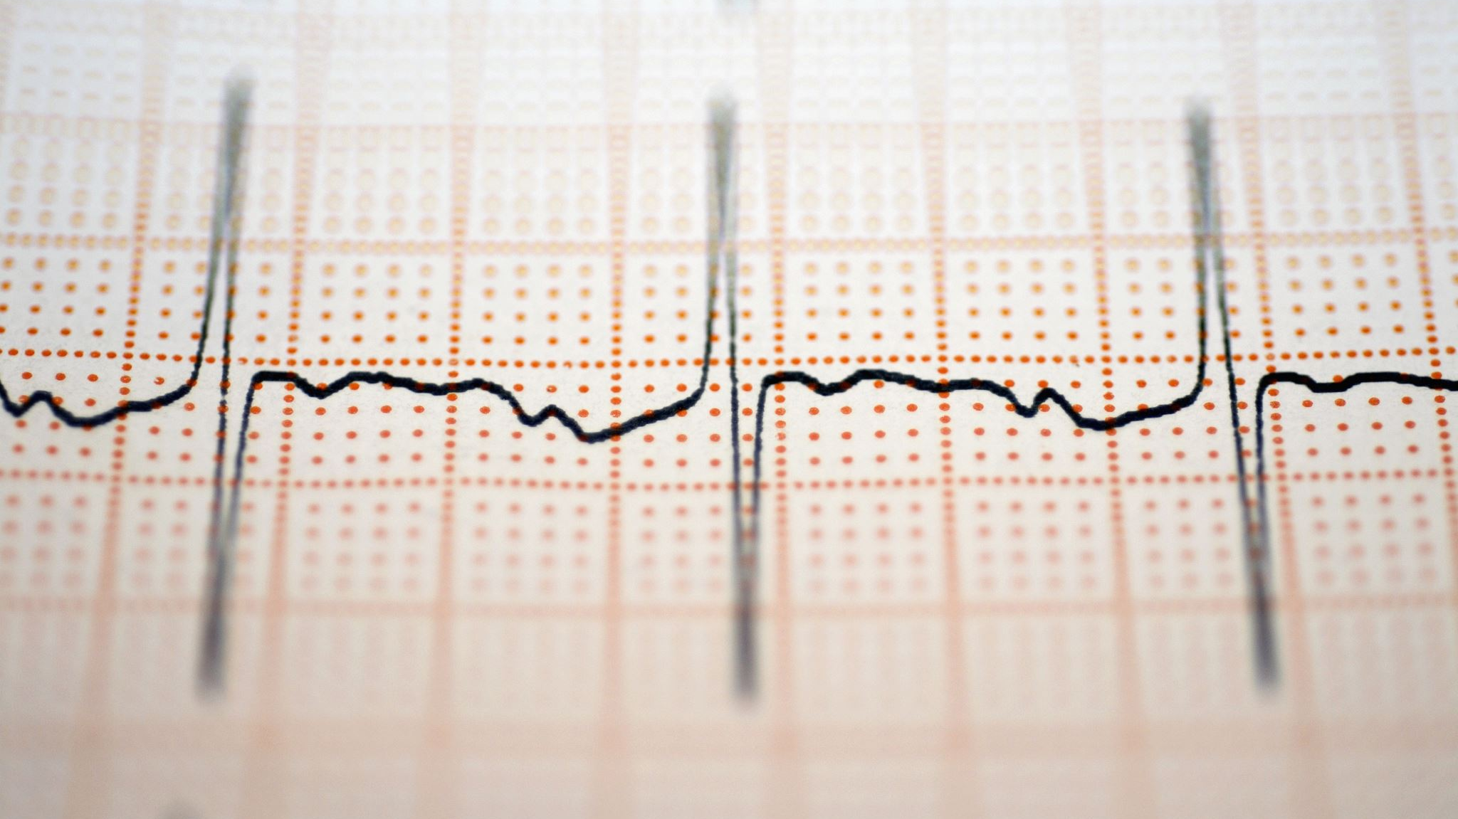

2-day Workshop EEG

Slide 2
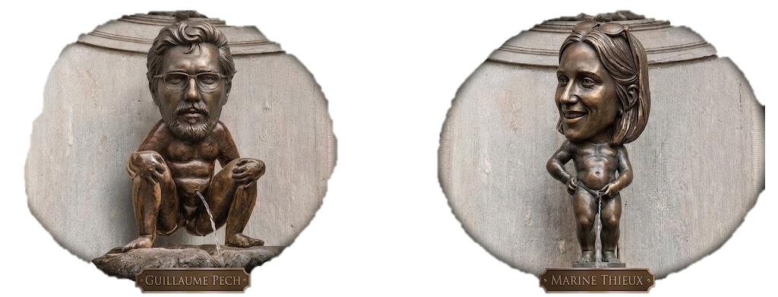

Slide 3
General program
Session1 – What EEG is?
Session2 – How to set-up an EEG?
Session3&4 – How to process EEG signal?
Session5&6 – How to extract & analyse EEG signal – time & time-frequency?
(Optional) Session7&8 – Introduction of some advanced methods on EEG

Slide 4
Goals of the workshop
Introducing main EEG concepts & analysis – broaden your perspective
Focus on what matters most – not exhaustive
Familiarise with the MNE-python library
Share experience & ressources & codes

Slide 5
Program session1
History EEG – past, present, and future
EEG, what are we recording?
A main concern of EEG recording, improving Signal to Noise Ratio

Slide 6
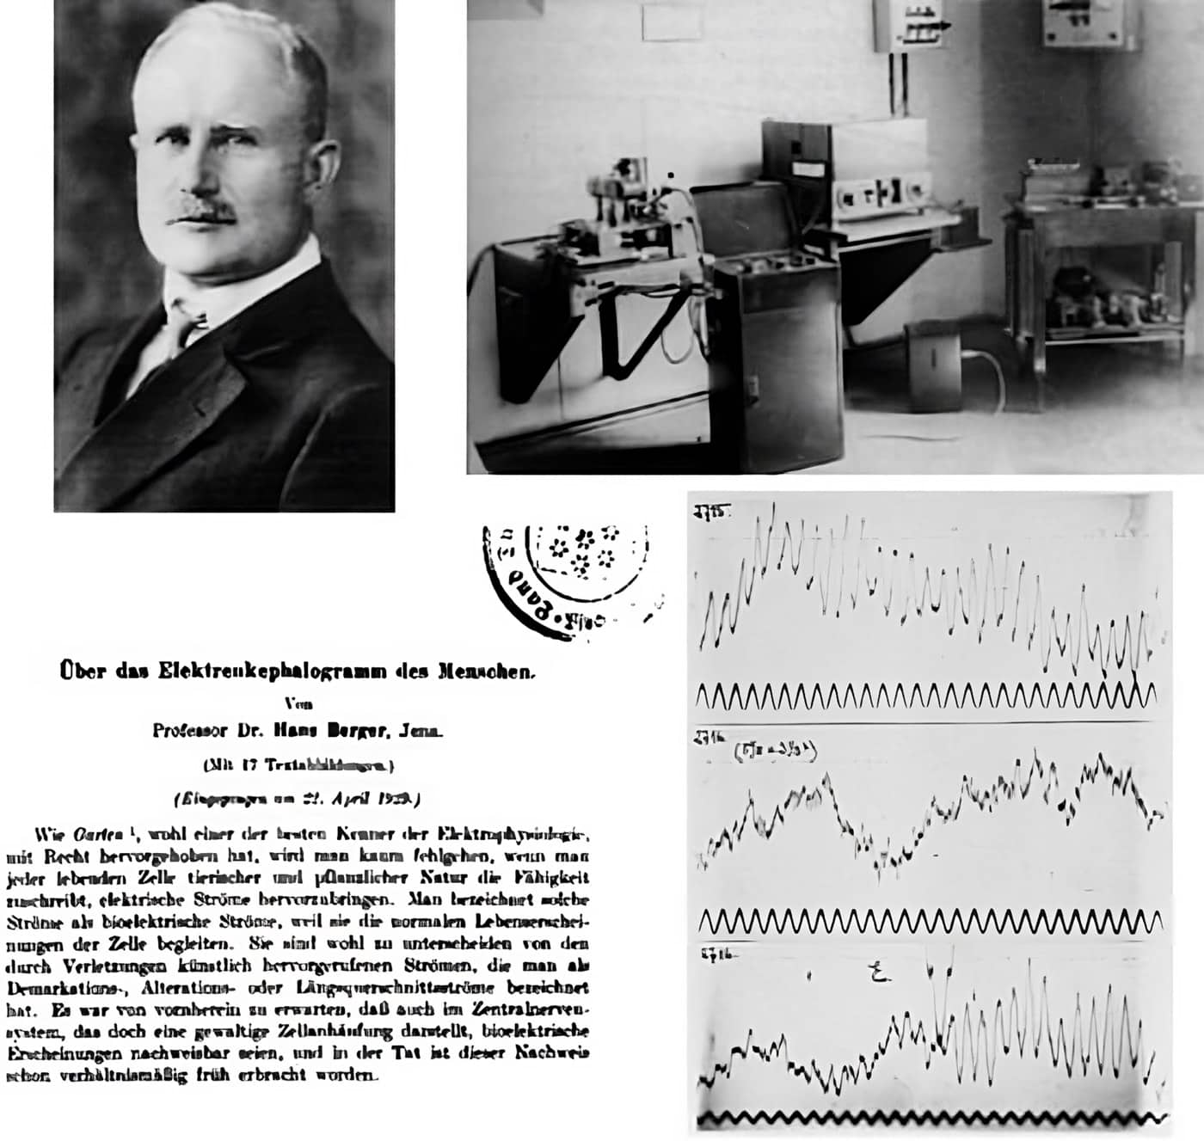
History
Past
On July 6th 1924, Hans Berger performed the first-ever recording of the electroencephalogram from a human.

Slide 7
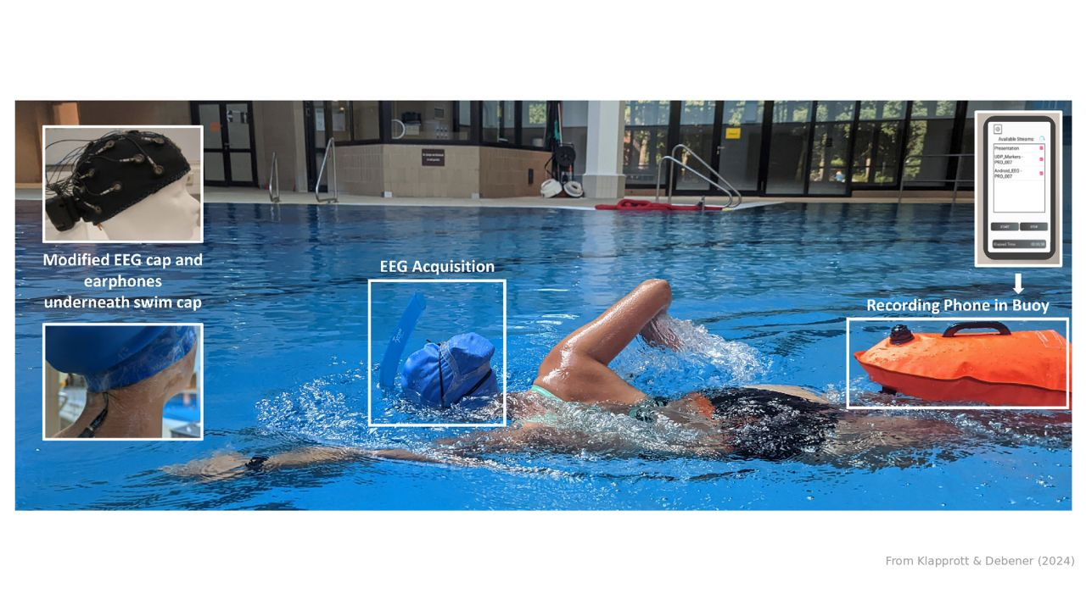
History
Past
History
Present

Slide 8
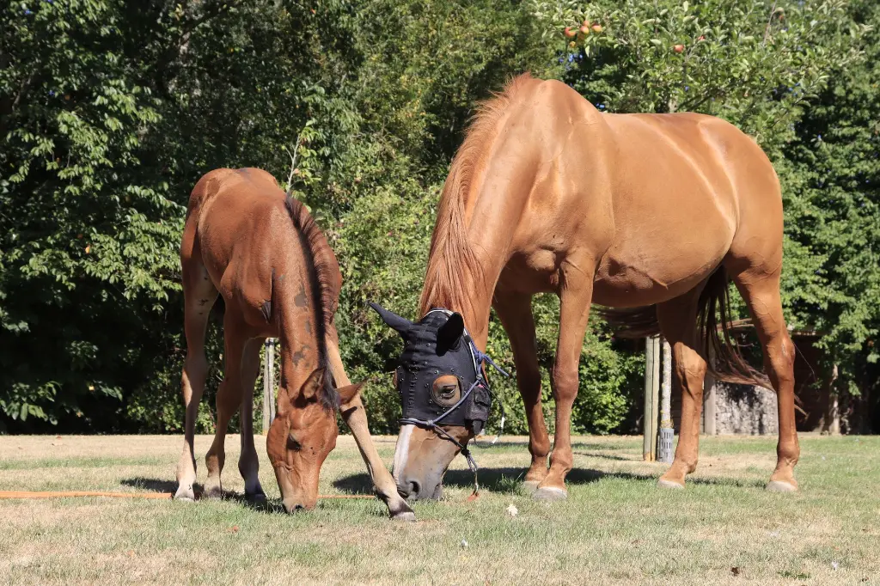
History
Past
History
Present

Slide 9
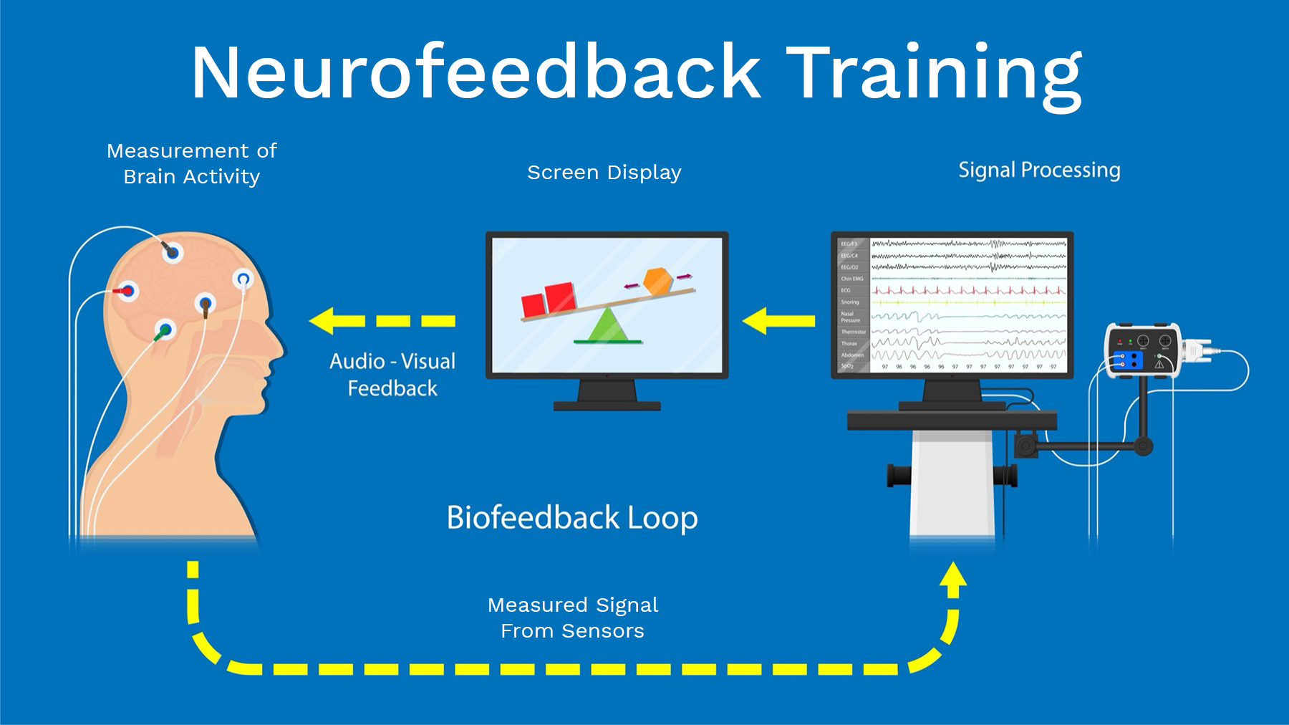
History
Past
History
Present

Slide 10
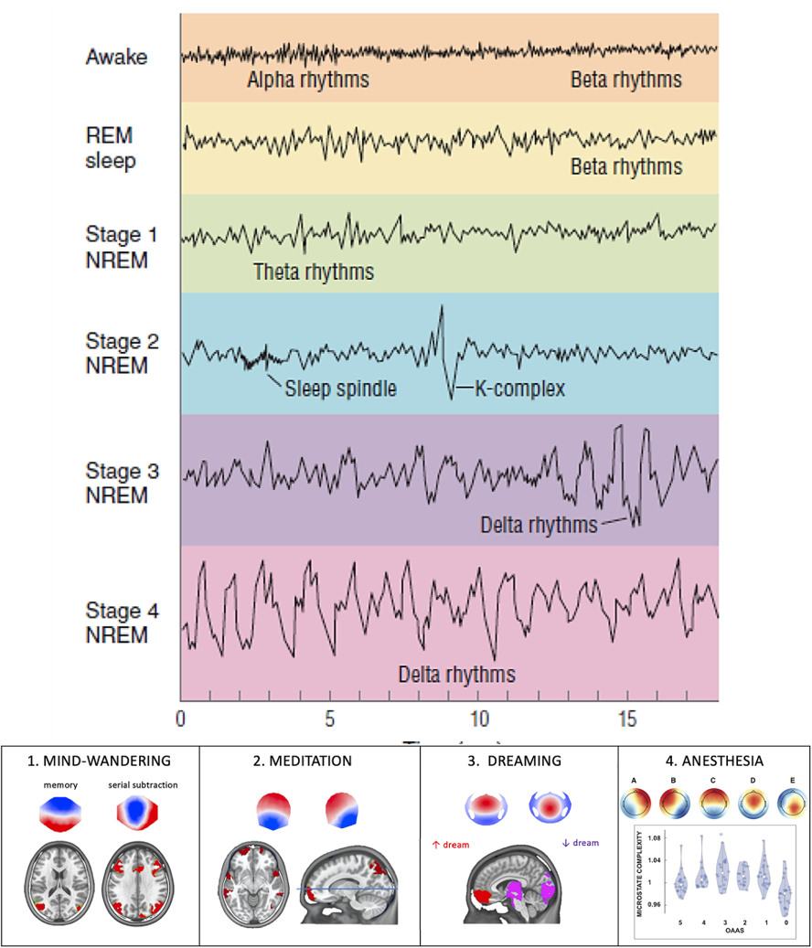
History
Past
History
Present

Slide 11
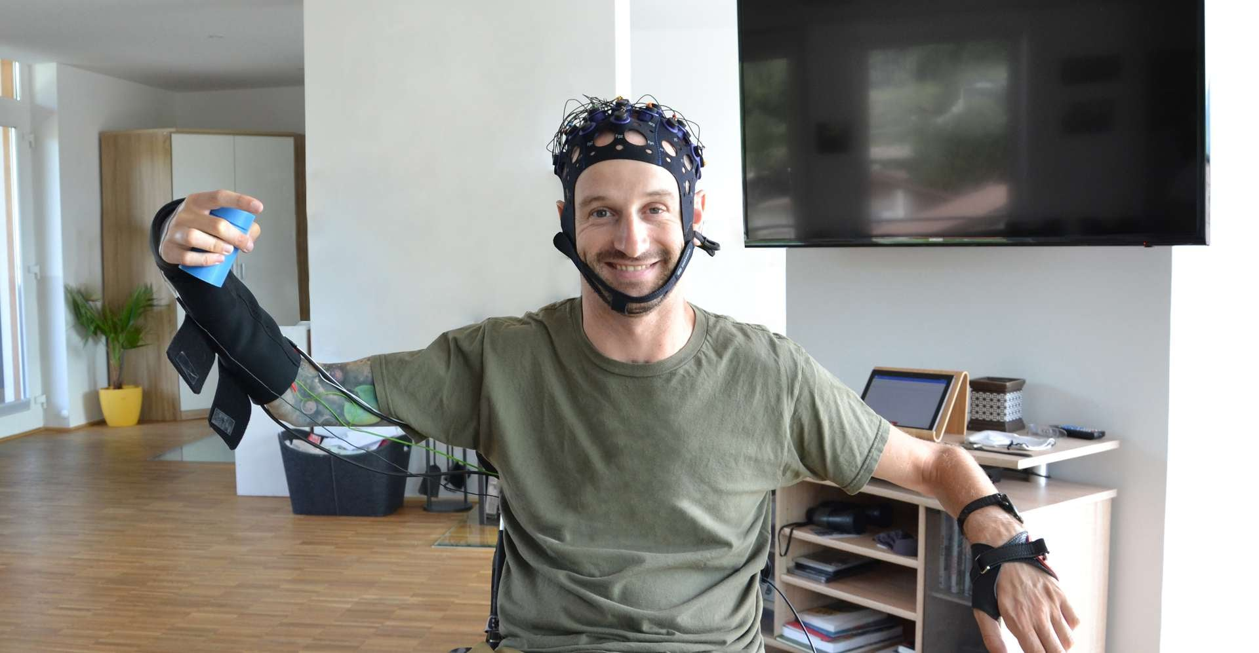
History
Past
History
Present

Slide 12
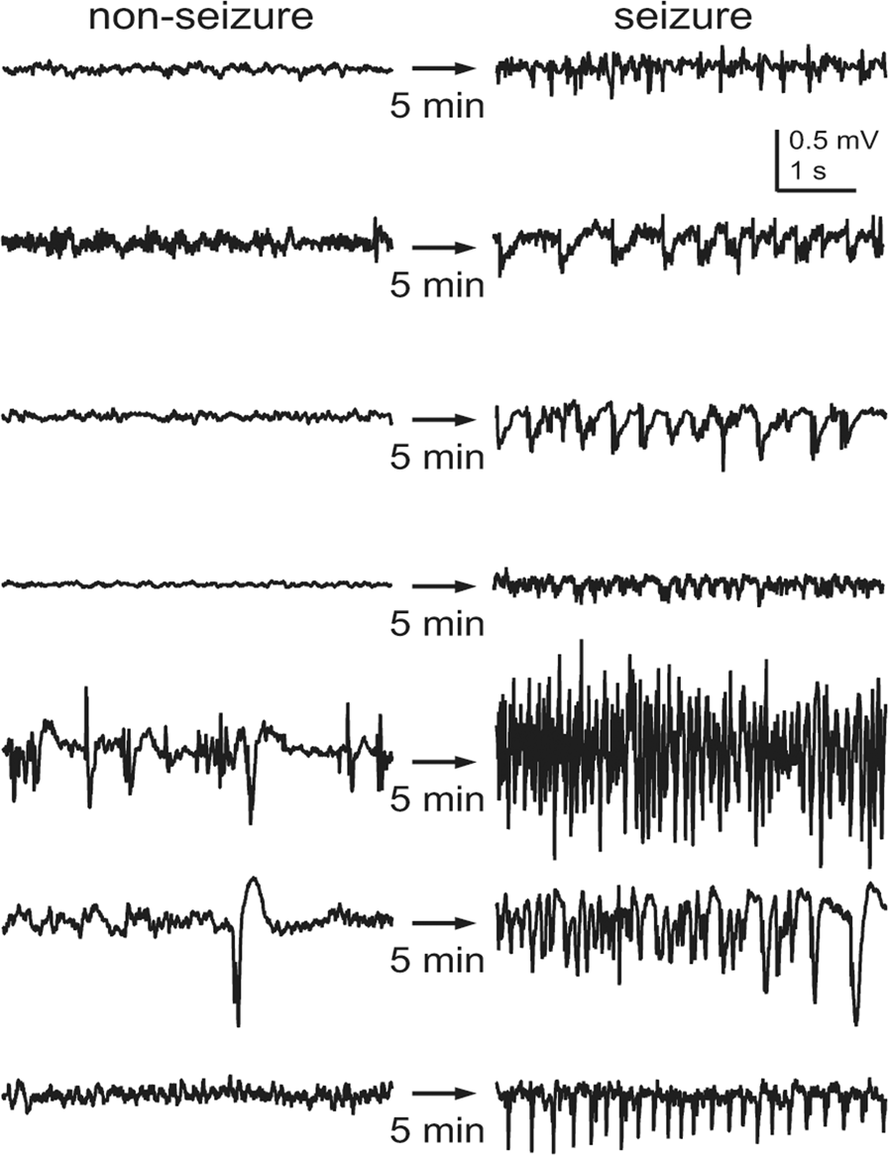
History
Past
History
Present

Slide 13
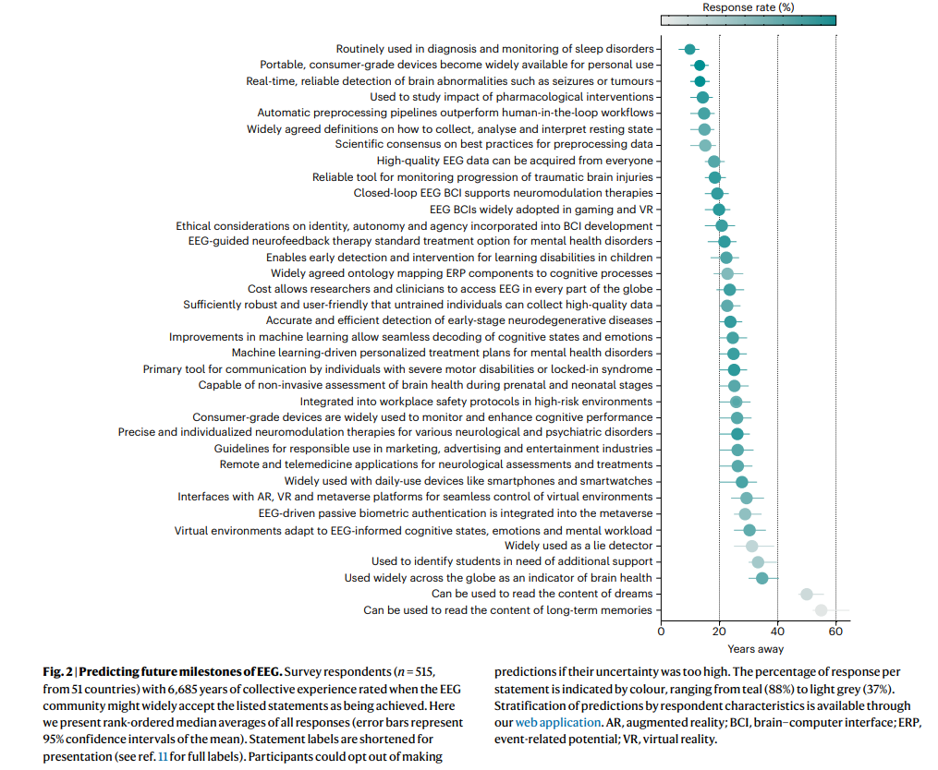
History
Past
History
Present
History
Future
Mushtaq, F., Welke, D., Gallagher, A., Pavlov, Y. G., Kouara, L., Bosch-Bayard, J., ... & Valdes-Sosa, P. (2024). One hundred years of EEG for brain and behaviour research. Nature human behaviour, 8(8), 1437-1443.

Slide 14
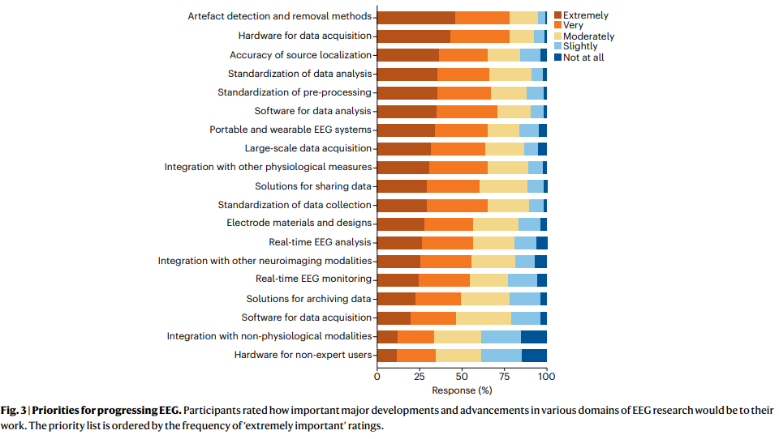
History
Past
History
Present
History
Future
Mushtaq, F., Welke, D., Gallagher, A., Pavlov, Y. G., Kouara, L., Bosch-Bayard, J., ... & Valdes-Sosa, P. (2024). One hundred years of EEG for brain and behaviour research. Nature human behaviour, 8(8), 1437-1443.

Slide 15
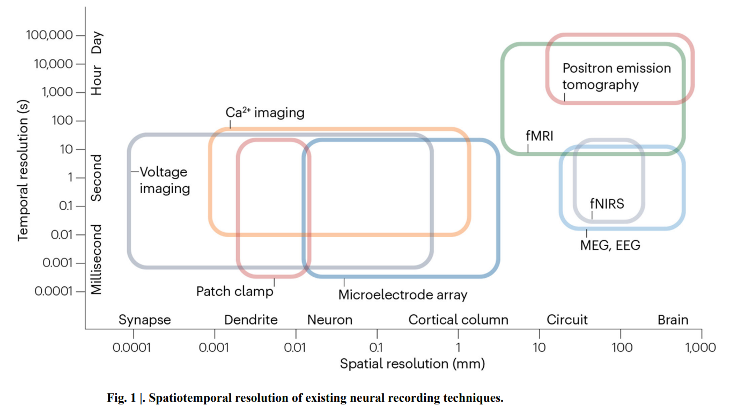
History
Past
History
Present
History
Future
EEG
What?
“EEG is a non-invasive neuroimaging technique used to record the electrical activity of the brain via electrodes placed on the scalp.
The recorded signal — the electroencephalogram (which shares the acronym EEG) — is the product of synchronized synaptic activity in populations of cortical neurons (pyramidal cells organized along cortical columns).
Voltage fluctuations at each electrode site reflect a differential measurement between the active and reference electrodes that is amplified and recorded as an EEG trace. These electrical changes can be captured with high temporal resolution and offer a window into the time course of brain activity in the submillisecond range.”
Mushtaq, F et al., (2024). Nature human behaviour
Ramezani, et al., (2025). Nature reviews electrical engineering, 2

Slide 16

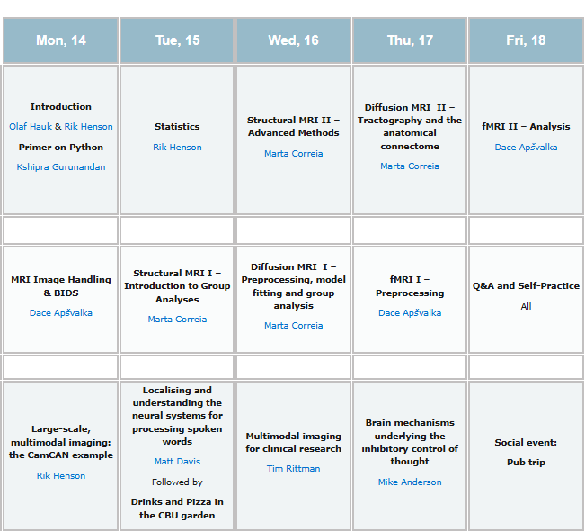
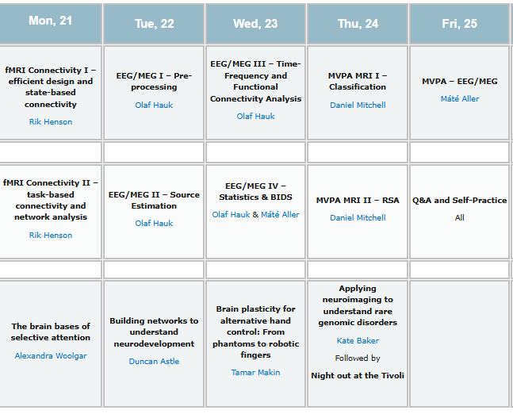

Slide 17
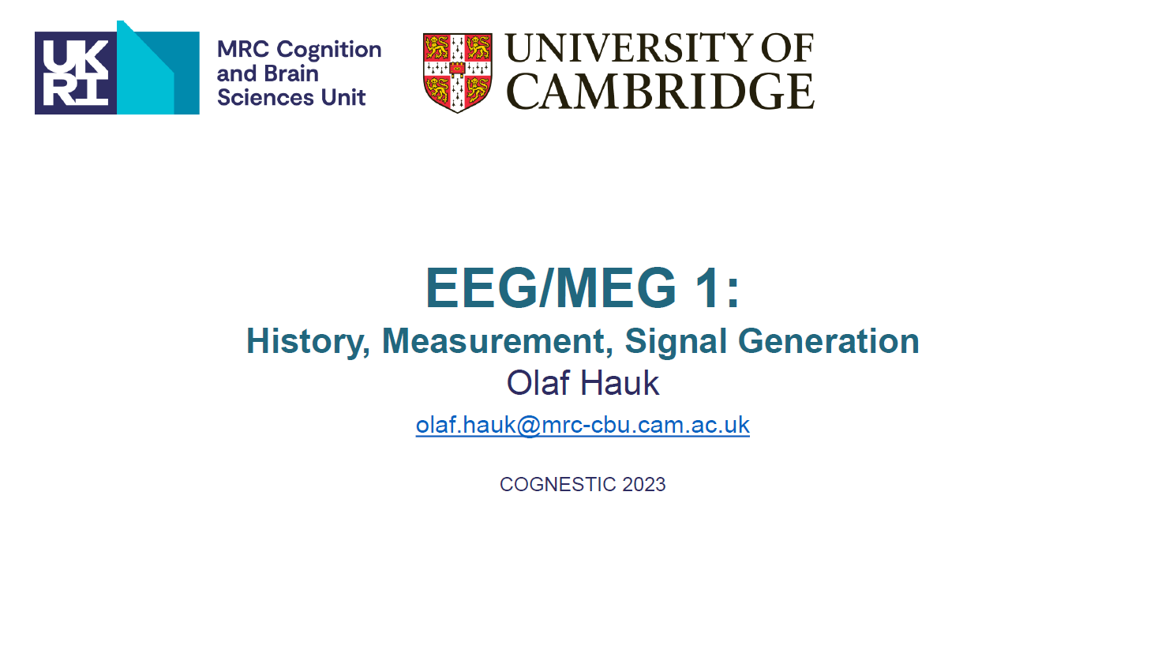

Slide 18
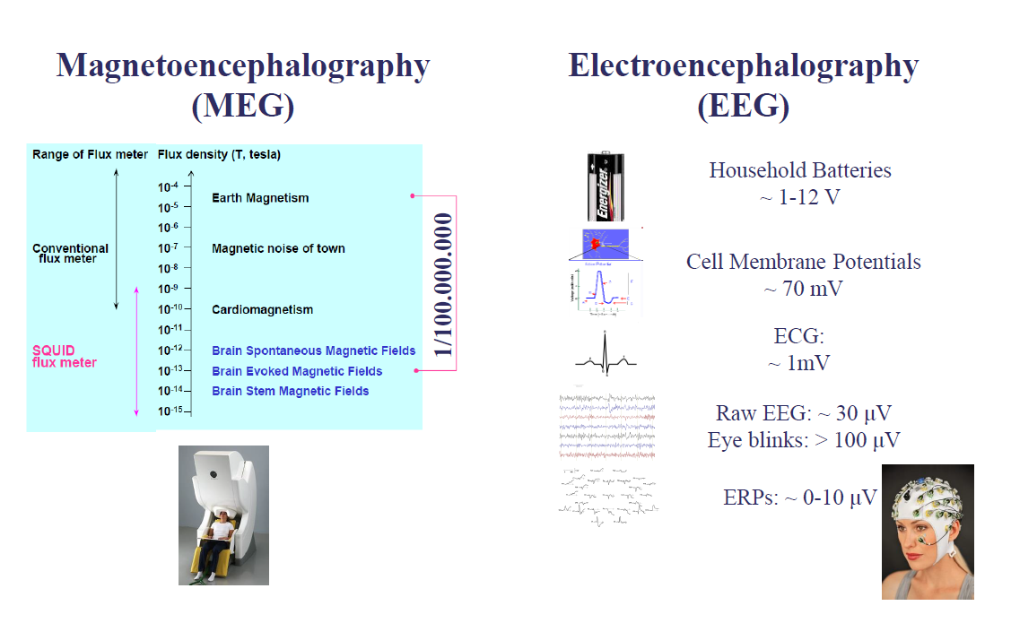
History
Past
History
Present
History
Future
EEG
What?

Slide 19
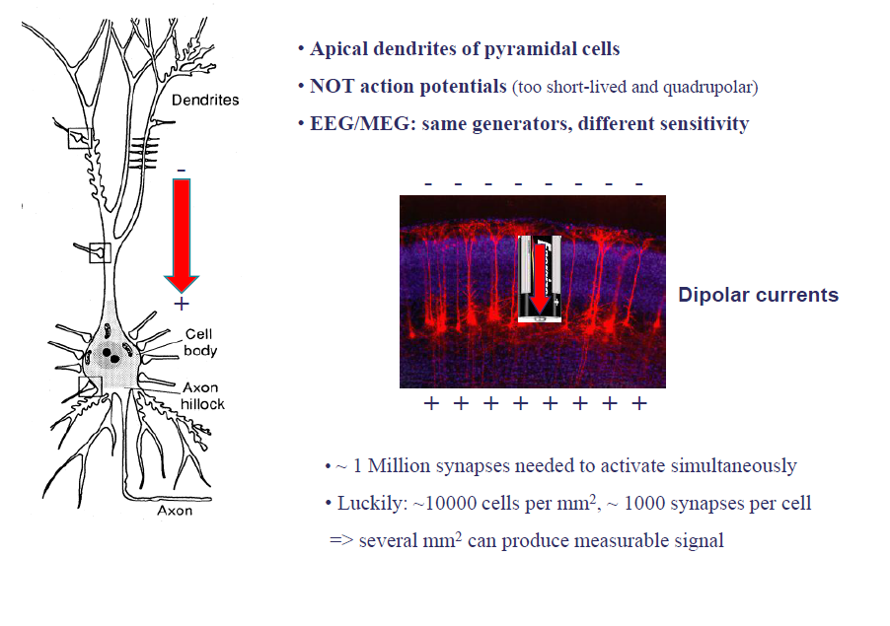
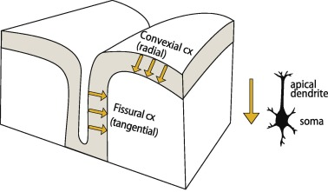
History
Past
History
Present
History
Future
EEG
What?

Slide 20
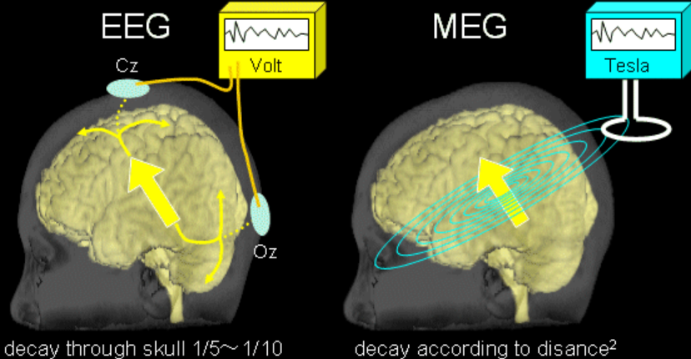
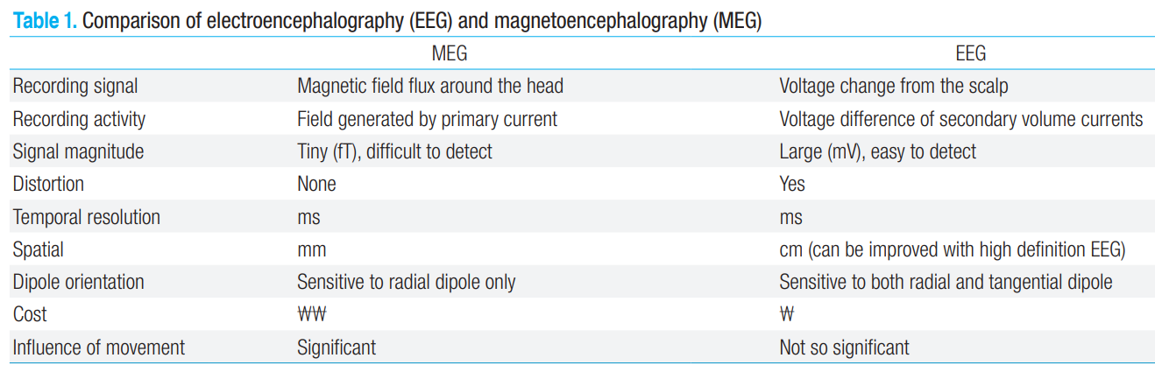
History
Past
History
Present
History
Future
EEG
What?
EEG
Vs MEG
https://meg.boy.jp/vsEEG/vsEEGE.html
Kim et al., (2013) Korean Journal of Pediatric

Slide 21
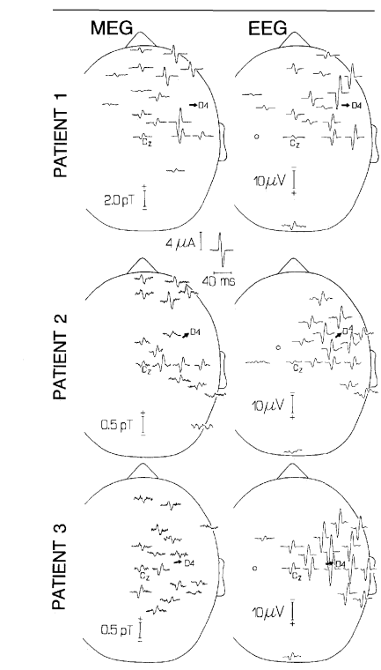
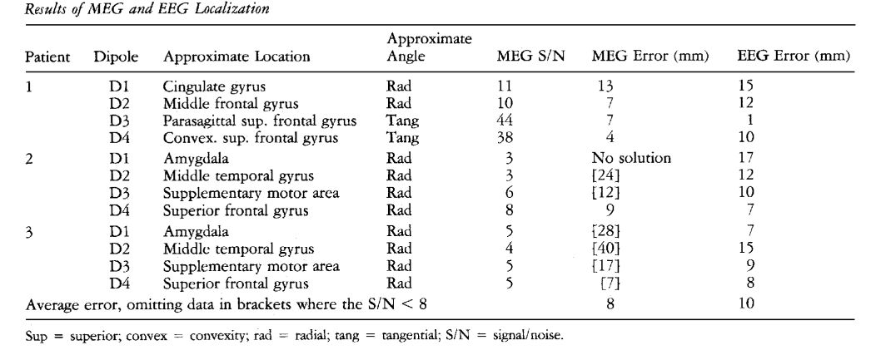
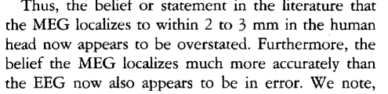
History
Past
History
Present
History
Future
EEG
What?
EEG
Vs MEG
Cohen et al., (1990) Annals of Neurology

Slide 22
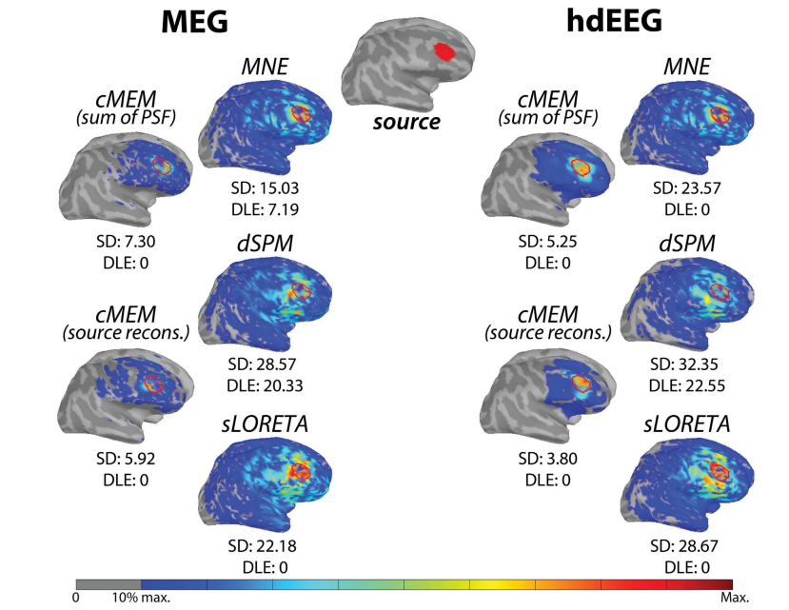
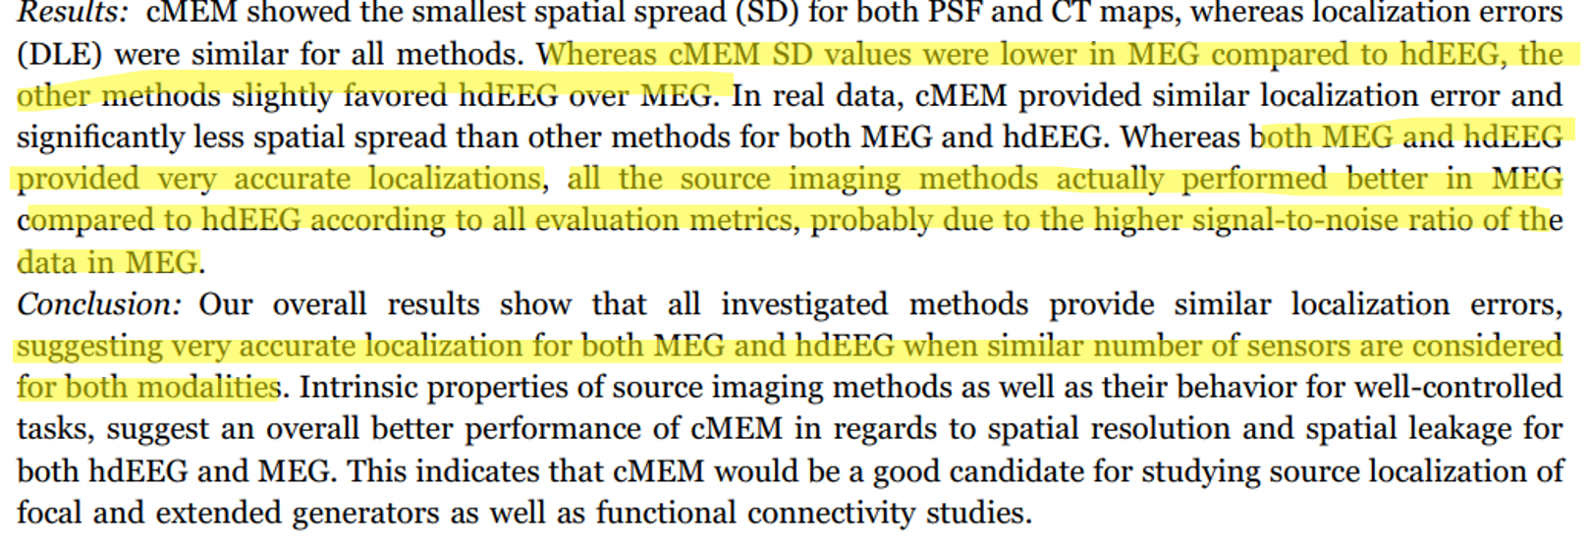
History
Past
History
Present
History
Future
EEG
What?
EEG
Vs MEG
Hedrich et al., (2017) Neuroimage

Slide 23
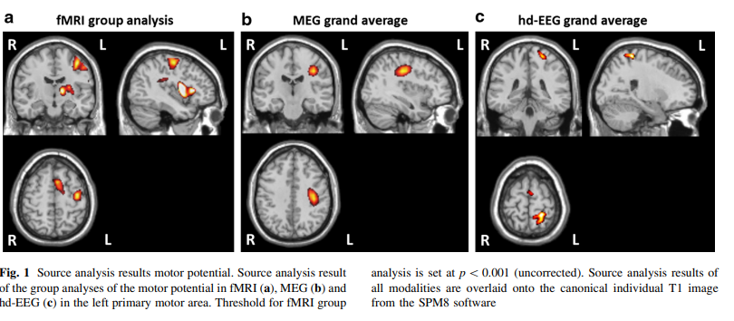
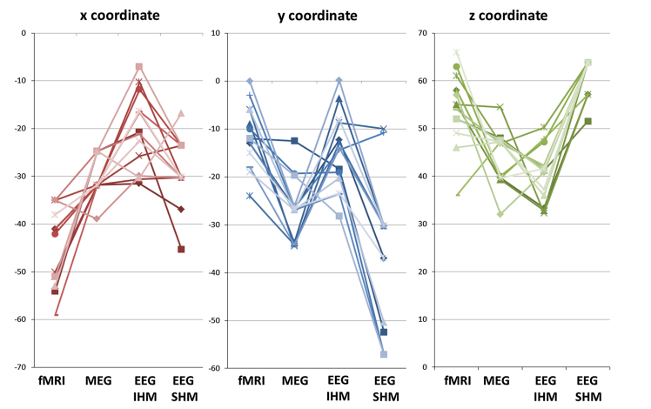
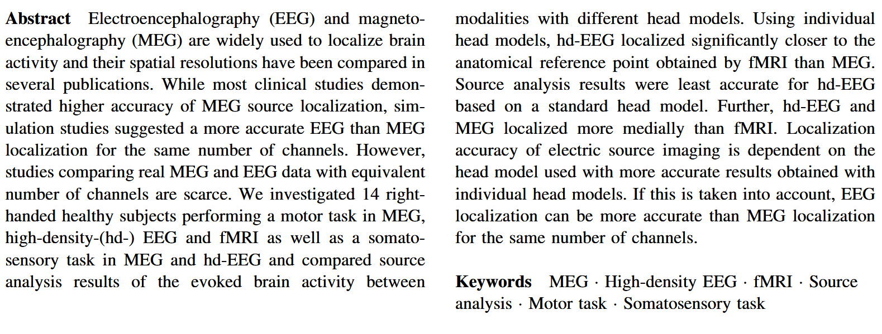
History
Past
History
Present
History
Future
EEG
What?
EEG
Vs MEG
Klamer et al., (2014) Brain Topography
IHM individual head model
SHM standard head model

Slide 24
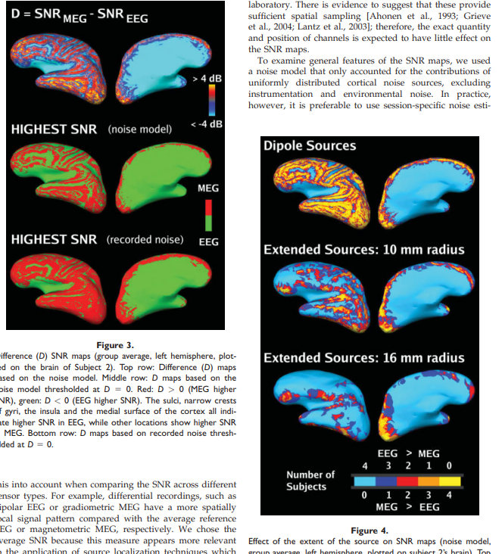
History
Past
History
Present
History
Future
EEG
What?
EEG
Vs MEG
Goldenholz et al., (2009) Human Brain Mapping

Slide 25
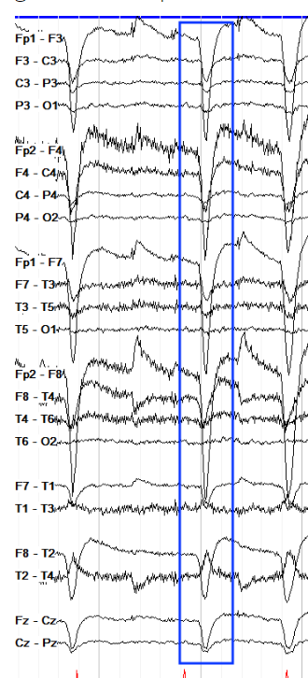
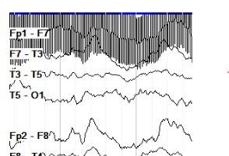
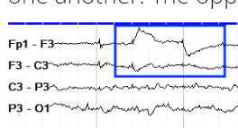
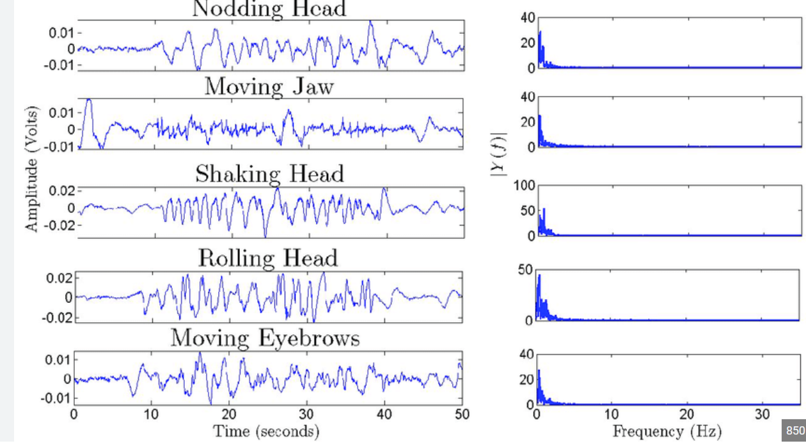
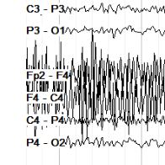
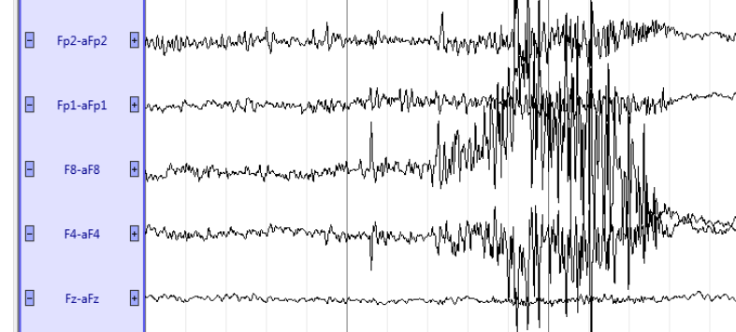
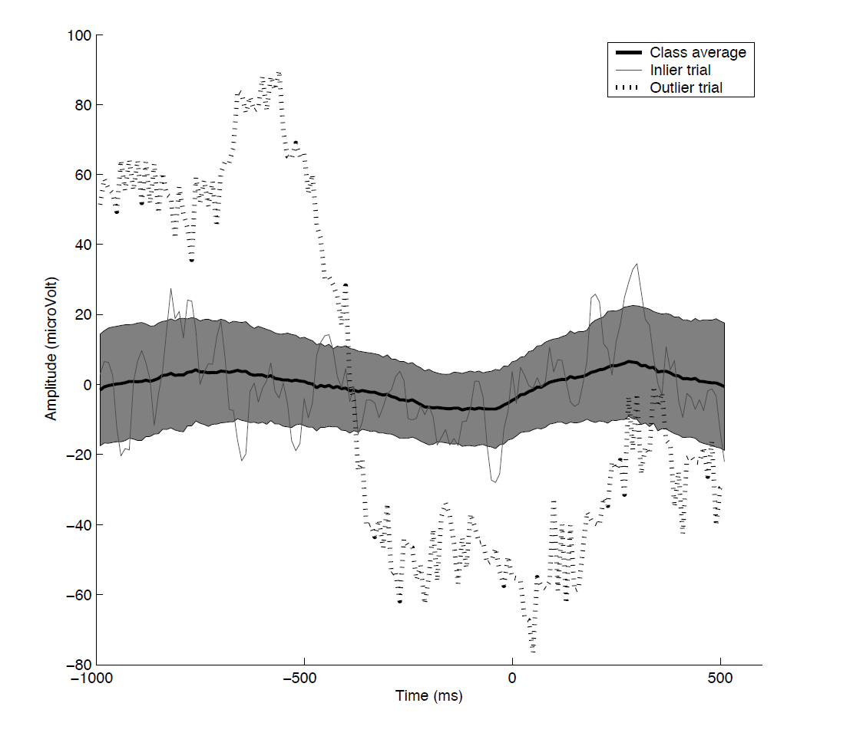
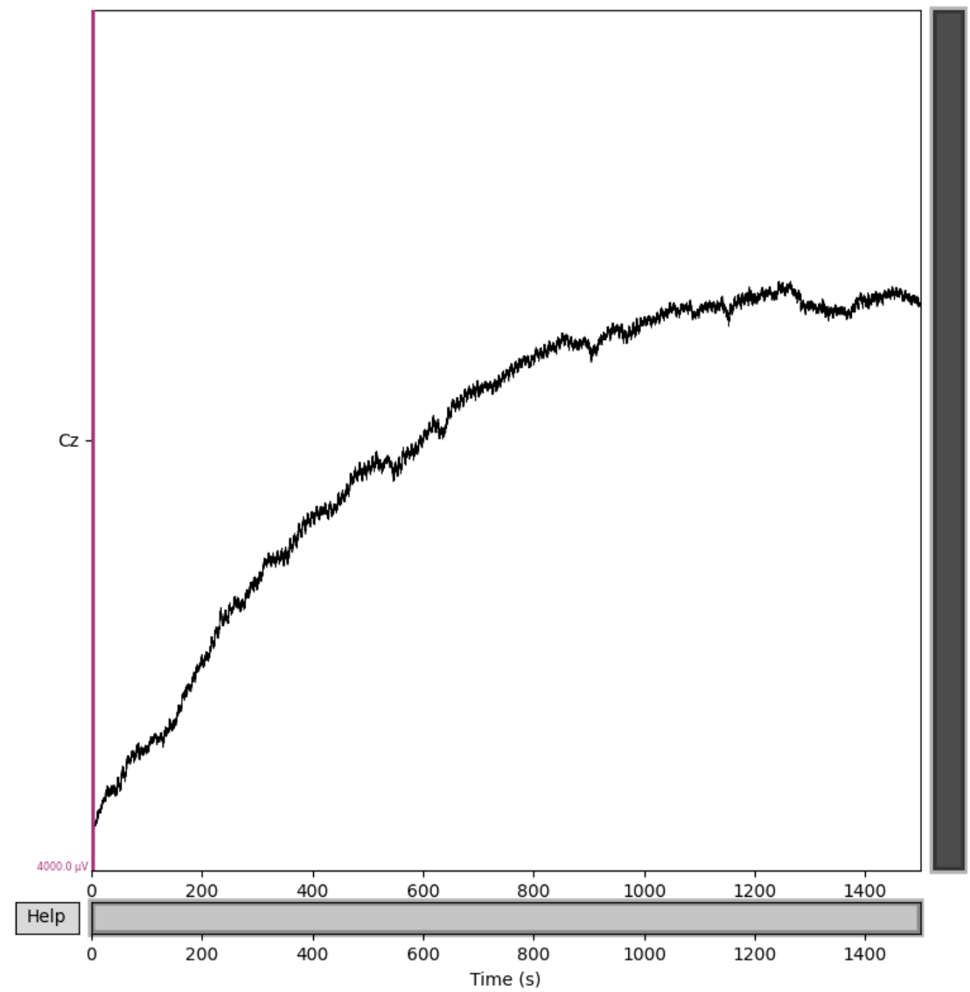
History
Past
History
Present
History
Future
EEG
What?
EEG
Vs MEG
SNR
What?
Eye blink
Line noise (electronic device)
Eye saccade
Muscular activity
Motion
Slow-drift
Abnormal recorded activities
(outliers)

Slide 26
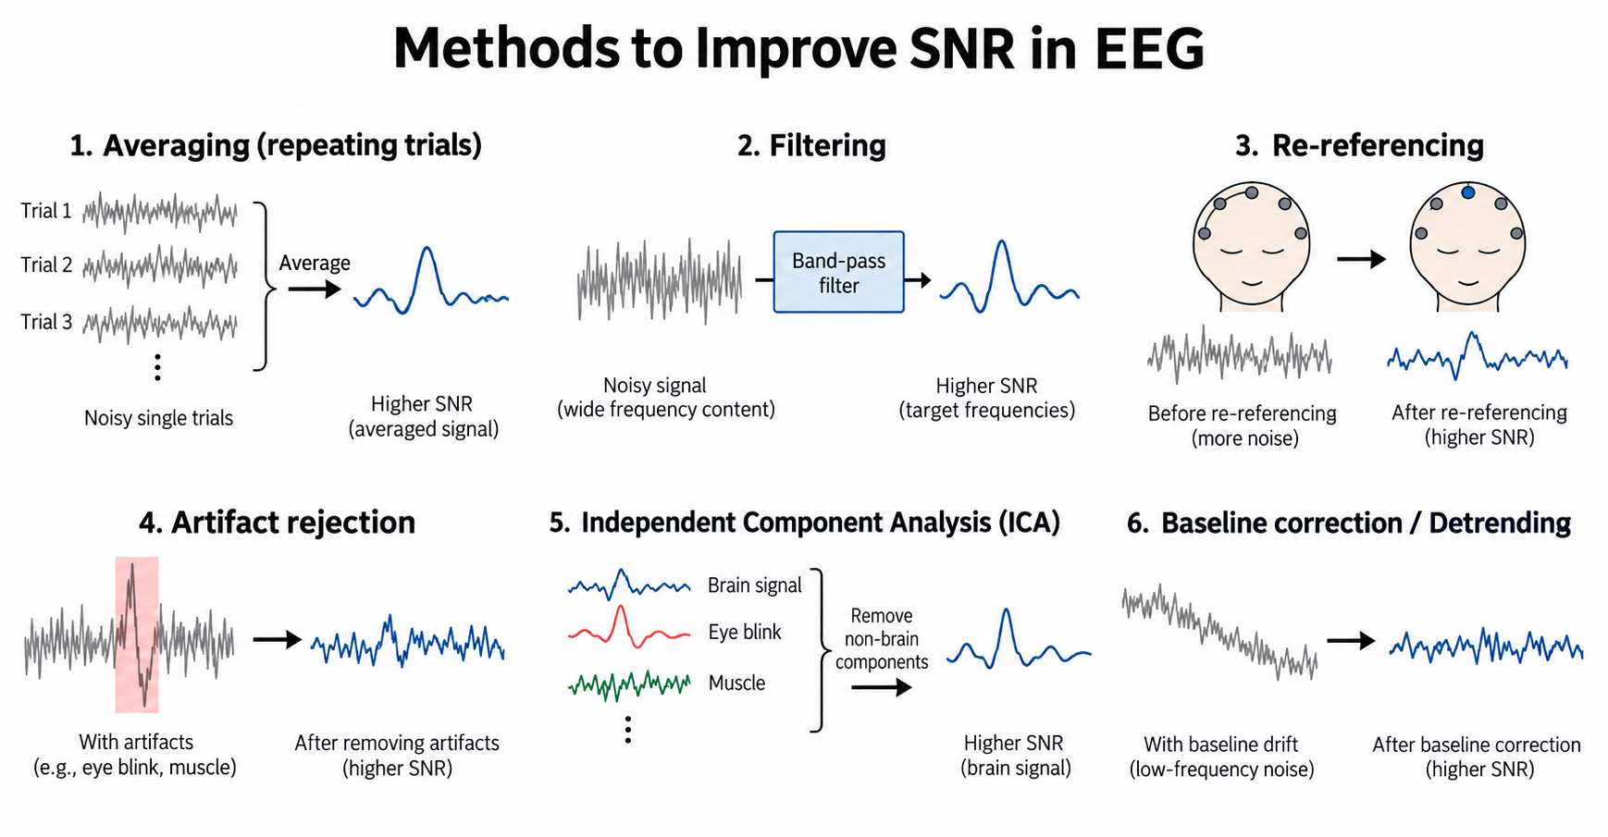
History
Past
History
Present
History
Future
EEG
What?
EEG
Vs MEG
SNR
What?
SNR
How?

Slide 27
